Slide 1
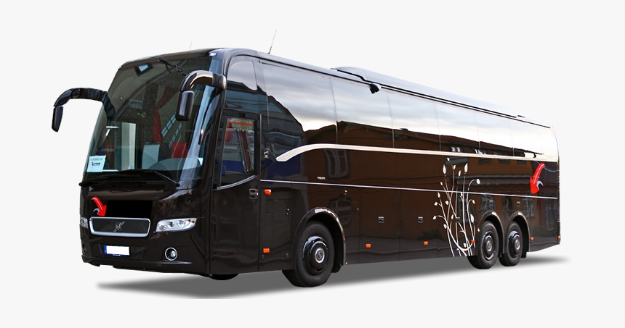
PRESENTATION ON "ONLINE BUS TICKET BOOKING SYSTEM".

Slide 2

A PROJECT PRESENTATION ON
Online bus ticket booking system
Submitted by,
Shruti Satish Sonawane. (roll no.71)
Neha Mangalsing Suryawanshi.(roll no.72)
Ritesh Rambhu Yadav. (roll no.79)
T.Y.B.C.A. (Science) [2021-2022]
Under the guidance of :- Prof.Priyanka Aher Ma'am.
(Department of Computer Science)
K.T.H.M College,Gangapur Road ,Nashik.

Slide 3
INTRODUCTION
This “Online Bus Ticket Booking System” project will provide an online bus ticket booking platform and thereby leverage the tedious manual ticket booking activity for a customer. We can provide a feature that will allow the customer to get a ticket booked without much hassle.
We can eliminate the drawbacks by developing an online website which will allow customers to register themselves and then they can search for buses, book tickets, cancel tickets and view bookings with feasibility. This actually is a welcome step for customers as they can book tickets from anywhere and will also avoid wastage of time that was caused due to the drawbacks in the previous way of booking tickets manually. Online system is type of time saving method.

Slide 4
Project Profile
PROJECT TITLE |  | ONLINE BUS TICKET BOOKING SYSTEM
OBJECTIVES |  | To make the ticket booking system of ticket booking agency simple, reliable, easy, user friendly and moreover less time consuming as compared to manual work.
FRONT END TOOL |  | PHP ,HTML5, CSS3
BACK END TOOL |  | MySQL
TYPE OF APPLICATION |  | AN ONLINE WEBSITE
INTERNAL GUIDE |  | PROF/MRS.PRIYANKA AHER
TIME DURATION |  | 80-90 DAYS
GROUP NO |  | G-31
DEPARTMENT |  | COMPUTER APPLICATION (TYBCA-SCIENCE)

Slide 5
Need of system
The computerized system was needed because there were following drawbacks in the present manual system.
Keeping record of all customers was a tedious job.
Searching a particular record was monotonous because it involved searching all entries which required more time.
Fine manipulation of records is done automatically in computerized system unlike manual system thus eliminating the chance of error.
Lack of data integrity in existing system.
Manual system is difficult and time consuming.
We need less manpower in new system.
Human errors are reduced.
Makes system user friendly.

Slide 6
Proposed System
Provides interactive interface through which a user can interact with different areas of website easily.
Proposed system will help user to book tickets without wasting Time and energy ,which is not possible in manual system.
It Provides convenience to book seats from your home/city.
You can print e-ticket.
It is best platform for booking affordable bus tickets.
Payment by online method.
Cancellation option is available.

Slide 7
Aim and objectives
The main aim of this study is to make the ticket booking system of ticket booking agency simple, reliable, easy, user friendly, and moreover less time consuming as compared to the manual work.
Providing a web-based system(website) ,where a customer can book bus ticket through an online method without a need to queue up at the counter to purchase a bus ticket.
Enabling customers to check the availability and types of buses online.

Slide 8
Hardware Software Requirements
Hardware Requirements
i3 Processor
4 GB RAM
500 GB HARDDISK
Software Requirements
OPERATING SYSTEM:- Windows, Linux
LANGUAGE:- HTML5, CSS3, PHP
SERVER :- XAMPP
BACKEND:- MySQL

Slide 9
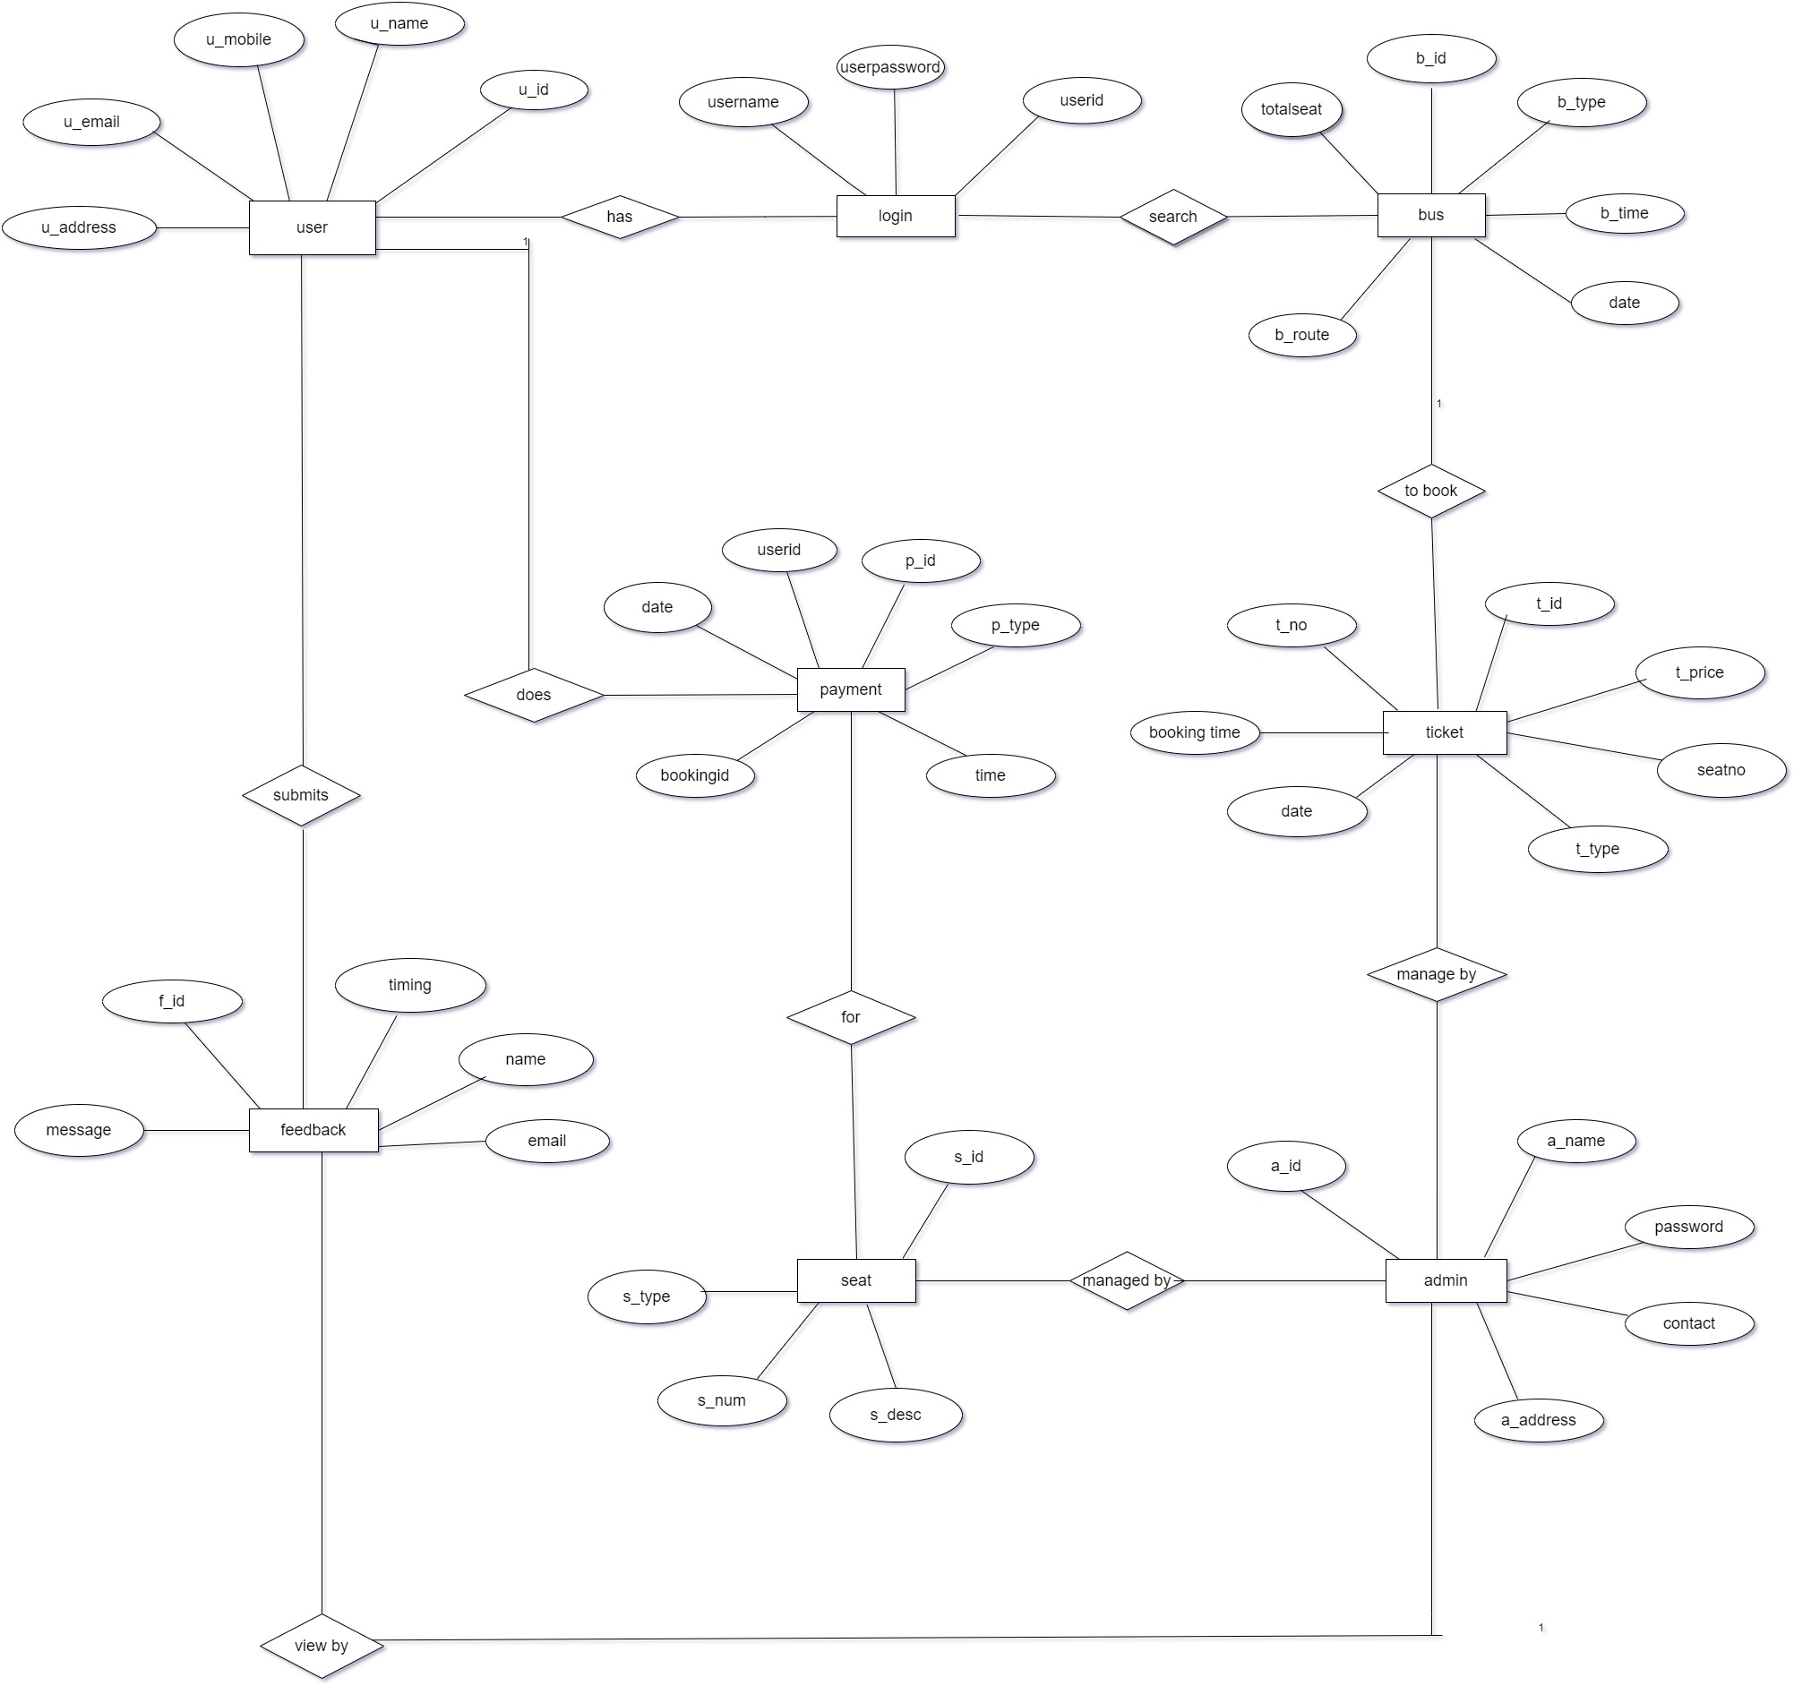
Er-diagram

Slide 10
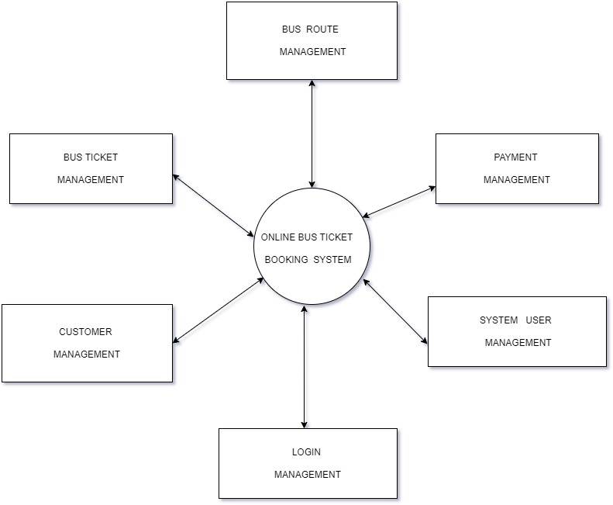
Dfd-level 0

Slide 11
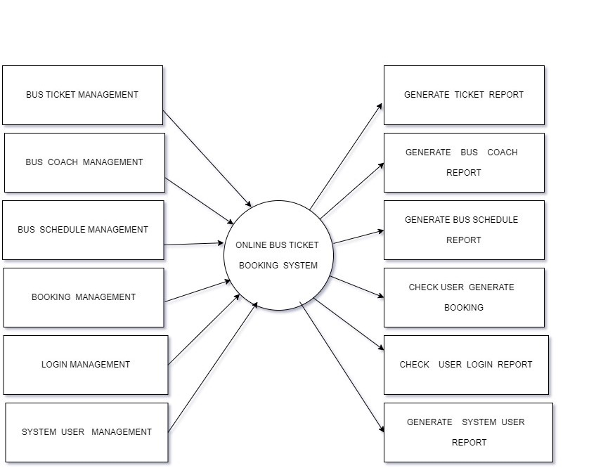
Dfd-level 1

Slide 12
User_tb Table
Primary key:-user_id
Description:-Provides information related user.
FIELD NAME | DATA TYPE | LENGTH | CONSTRAINT
user_id | int | 10 | Primary key
user_name | varchar | 20 | NOT NULL
user_birth | date |  | NOT NULL
user_gender | varchar | 6 | NOT NULL
user_email | varchar | 25 | Unique key
user_phone | bigint | 10 | Unique key
user_city | varchar | 20 | NOT NULL
user_password | varchar | 15 | NOT NULL

Slide 13
Addbus Table
Primary key: bus_no
Description:-Information about buses and their ticket price.
Data Dictionary
FIELD NAME | DATA TYPE | LENGTH | CONSTRAINT
bus_no | int | 10 | Primary key
bus_name | varchar | 20 | NOT NULL
bus_from | varchar | 20 | NOT NULL
bus_to | varchar | 20 | NOT NULL
total_seats | int | 60 | NOT NULL
bus_price | varchar | 10 | NOT NULL
bus_date | date |  | NOT NULL
arrival_time | time |  | NOT NULL
reach_time | time |  | NOT NULL

Slide 14
City Table :Primary key:-city_no
Description:-Information related cities.
FIELD NAME | DATA TYPE | LENGTH | CONSTRAINT
city_no | int | 10 | Primary key
city_name | varchar | 25 | NOT NULL
Contact_us Table: Primary key:-c_id
Description:-To make contact with admin side.
FIELD NAME | DATA TYPE | LENGTH | CONSTRAINT
c_id | int | 10 | Primary key
c_name | varchar | 20 | NOT NULL
c_email | varchar | 25 | NOT NULL
c_message | longtext |  | NOT NULL

Slide 15
Tblbooking Table
Primary key:-bus_id
Description:-Provides booking information.
FIELD NAME | DATA TYPE | LENGTH | CONSTRAINT
bus_id | int | 10 | Primary key
bus_no | int | 10 | Foreign key
bookedseats | varchar | 20 | NOT NULL
user_id | int | 10 | Foreign key
status | varchar | 20 | NOT NULL
ticketstatus | varchar | 20 | NOT NULL
month | int | 10 | NOT NULL
year | int | 10 | NOT NULL

Slide 16
Admin Table
Primary key:-admin_id
Description:-Information related admin.
FIELD NAME | DATA TYPE | LENGTH | CONSTRAINT
admin_id | int | 10 | Primary key
admin_name | varchar | 20 | NOT NULL
admin_password | varchar | 20 | NOT NULL

Slide 17
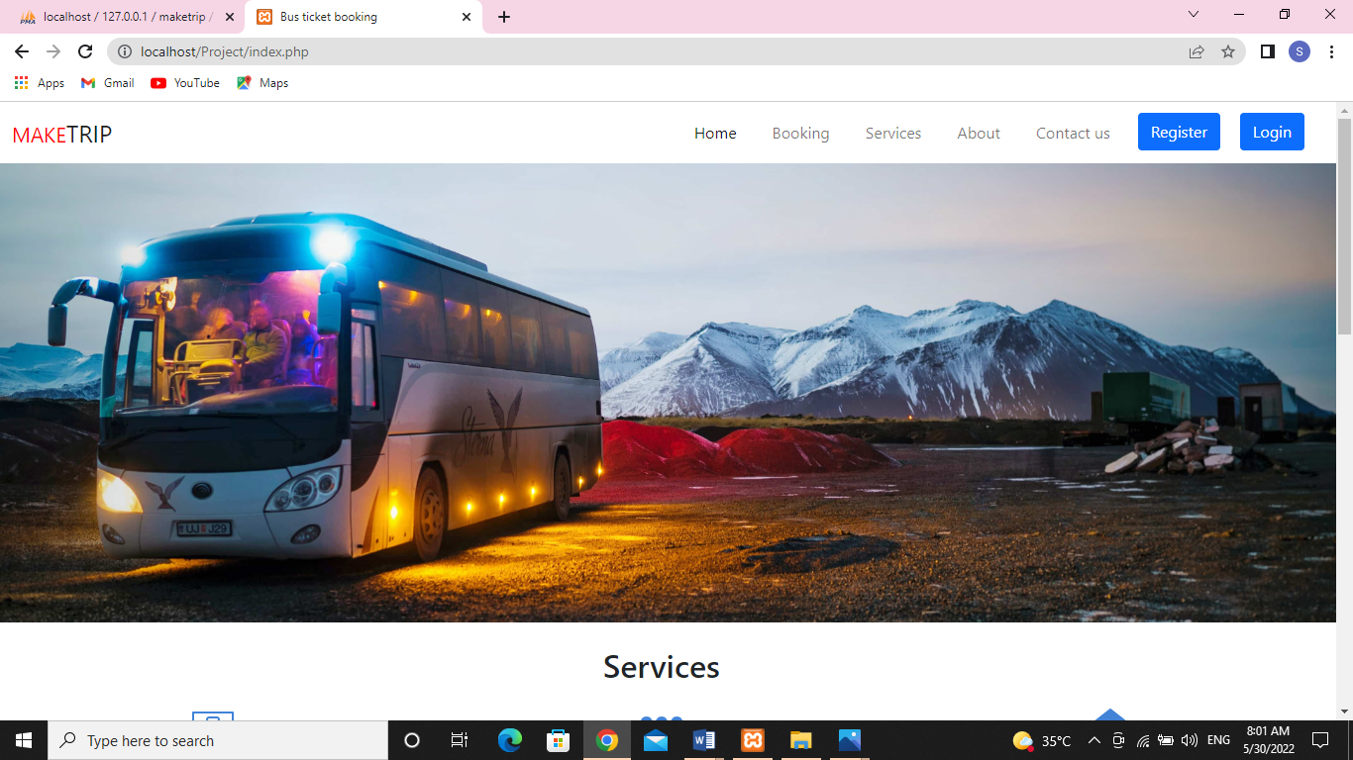
Homesreen for user and visitor.

Slide 18
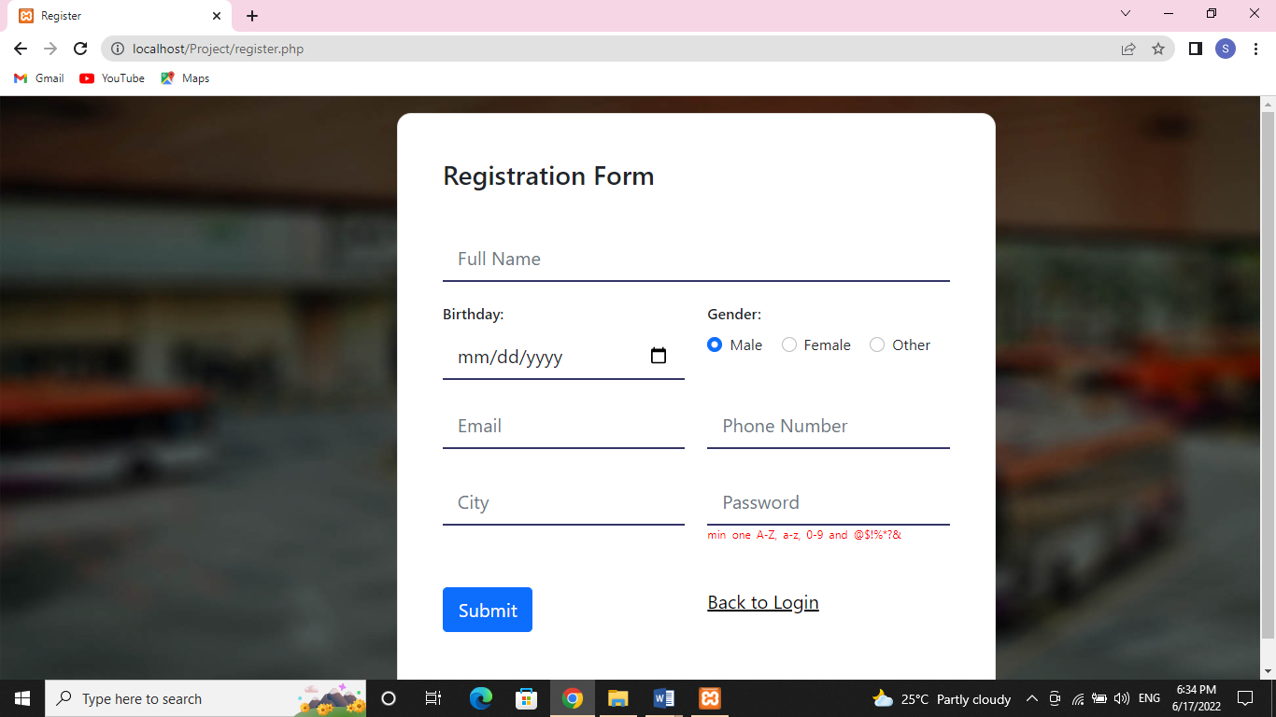
Registration page for user.

Slide 19
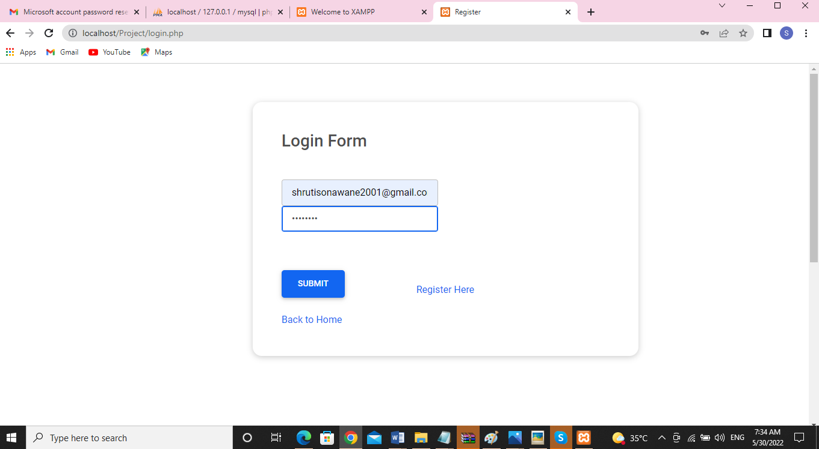
Login page for user.

Slide 20
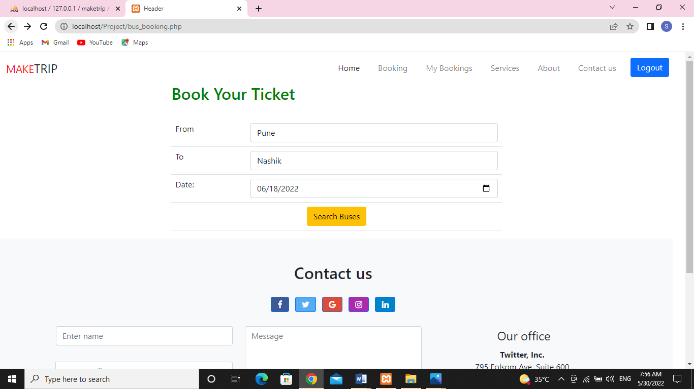
User search for buses.

Slide 21
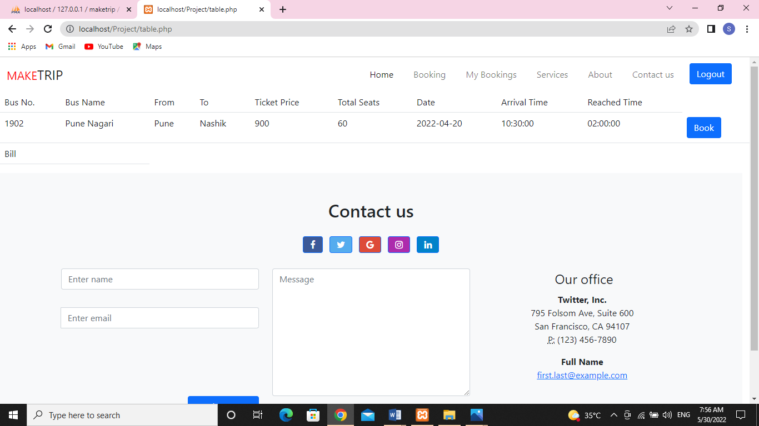
Available bus information is displayed

Slide 22
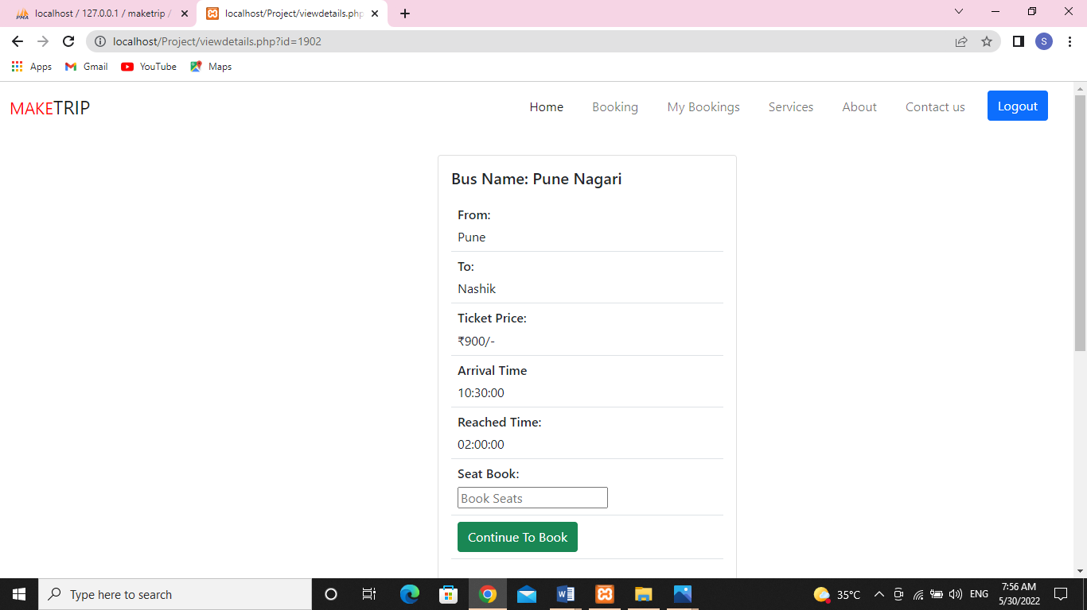
User can continue to book.

Slide 23
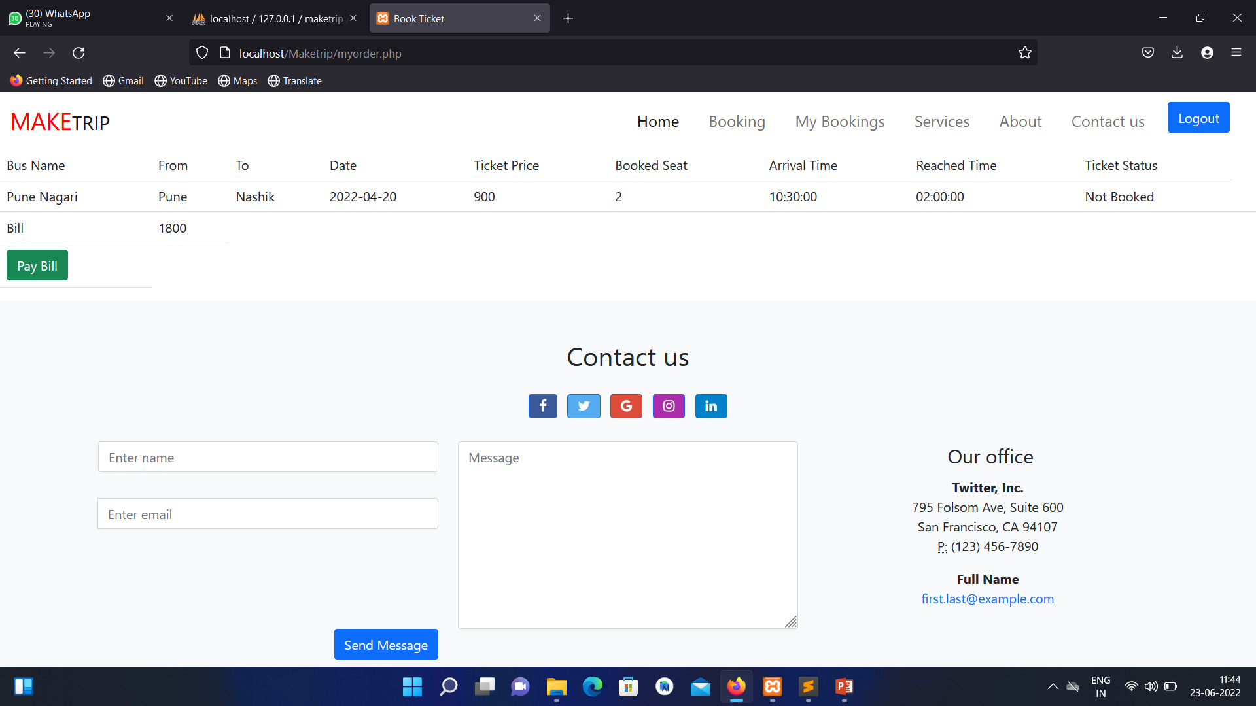
User information and booked ticket information is displayed.

Slide 24
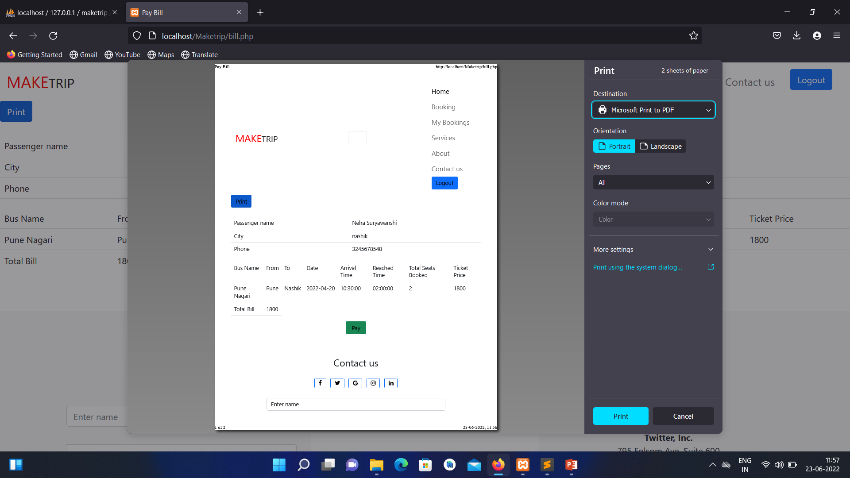
User can print ticket.

Slide 25
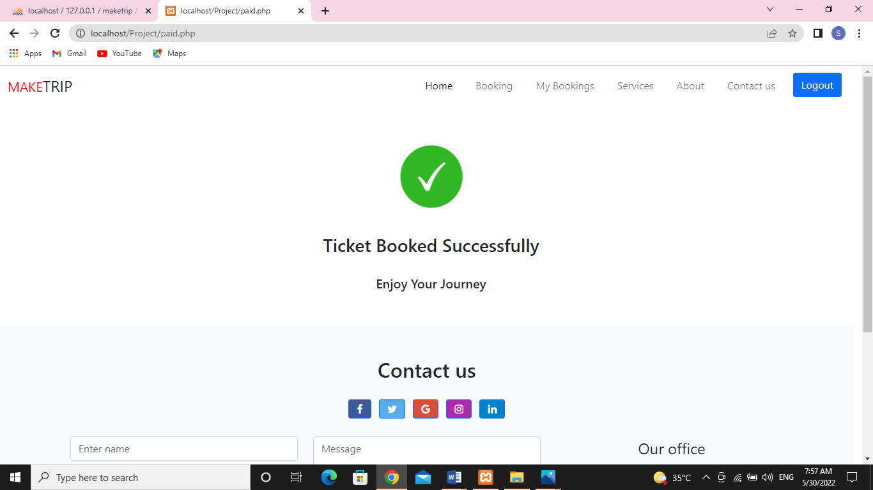
Booked successfully message displayed.

Slide 26
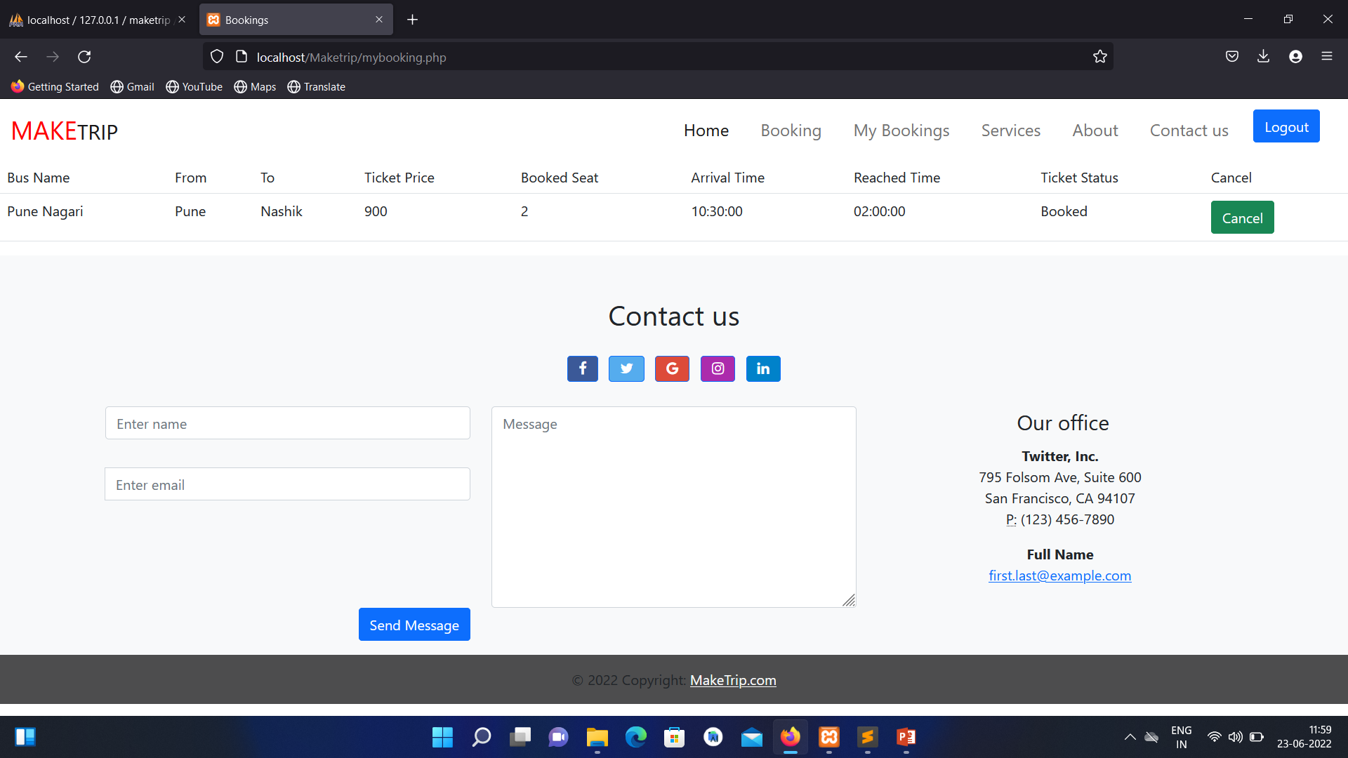
User can view his/her bookings and cancel booking on clicking “My Bookings”.

Slide 27
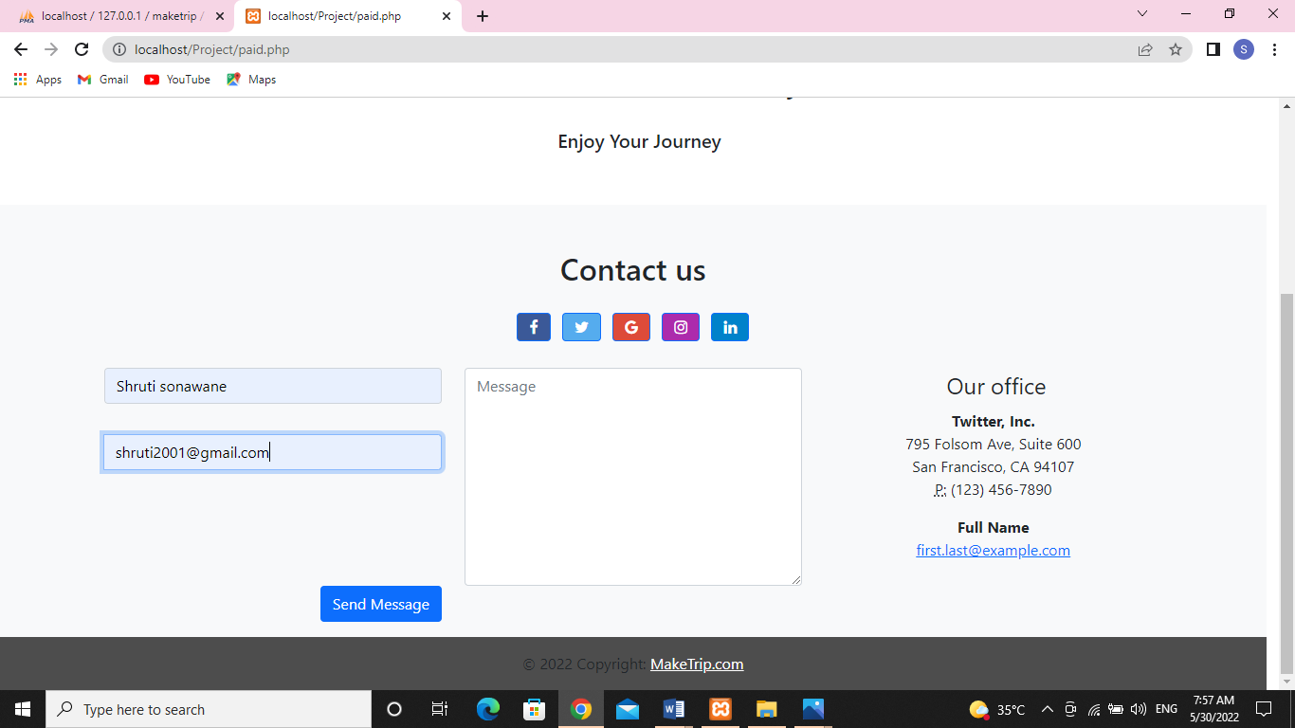
Contact us and feedback page.

Slide 28
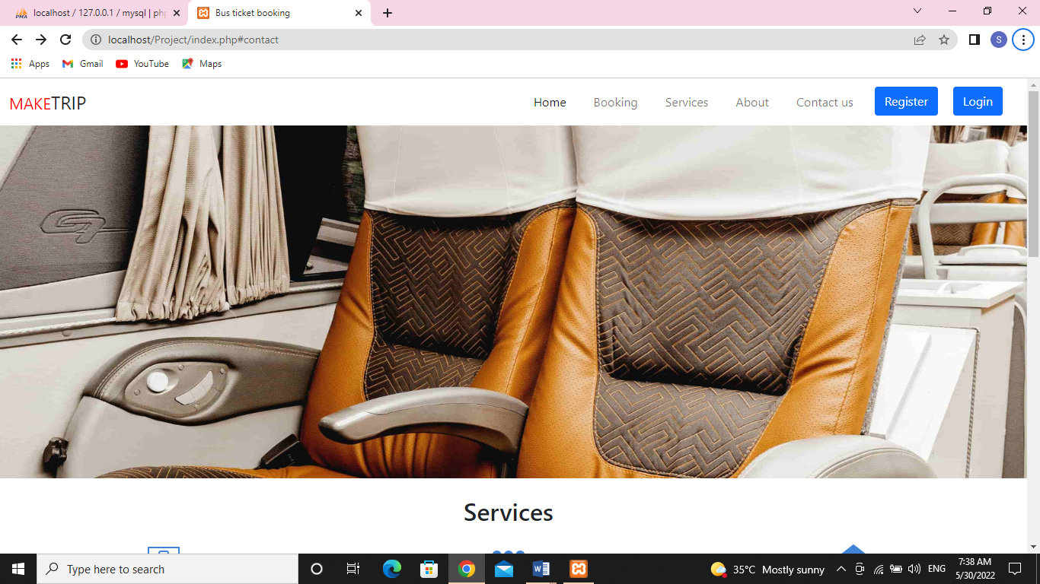
Provided services like comfortable seats,easy booking,affordable tickets.

Slide 29
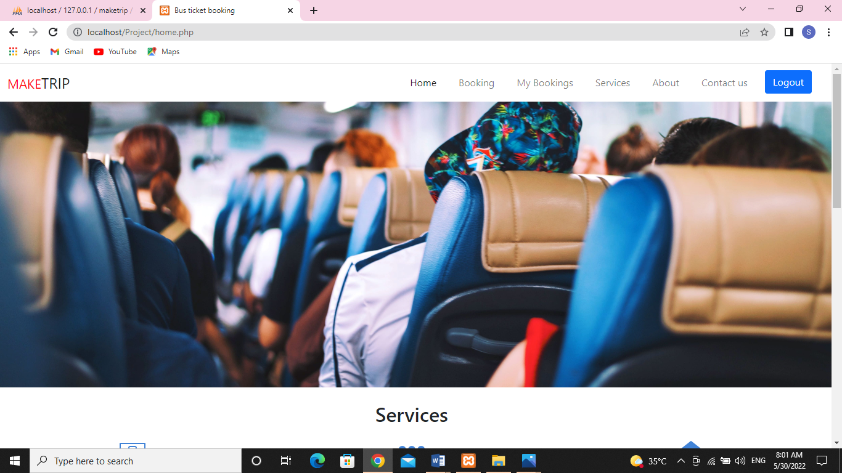
Logout page for user.

Slide 30
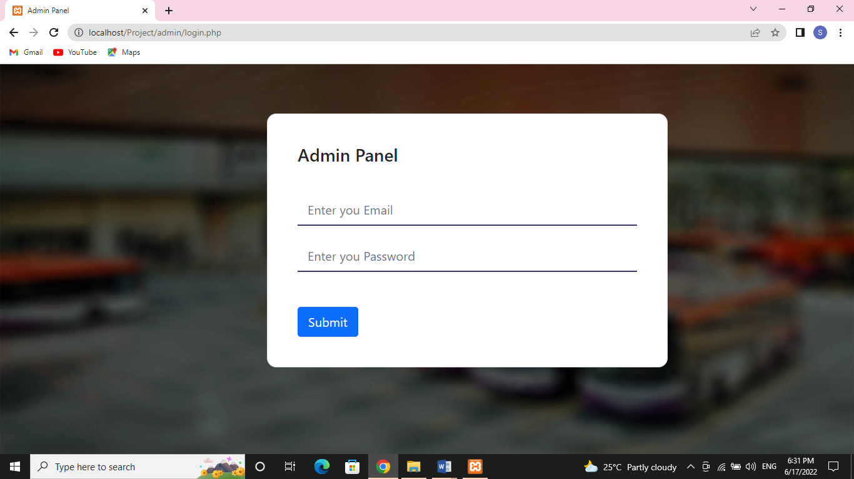
Admin side screens
Admin panel for admin side.

Slide 31
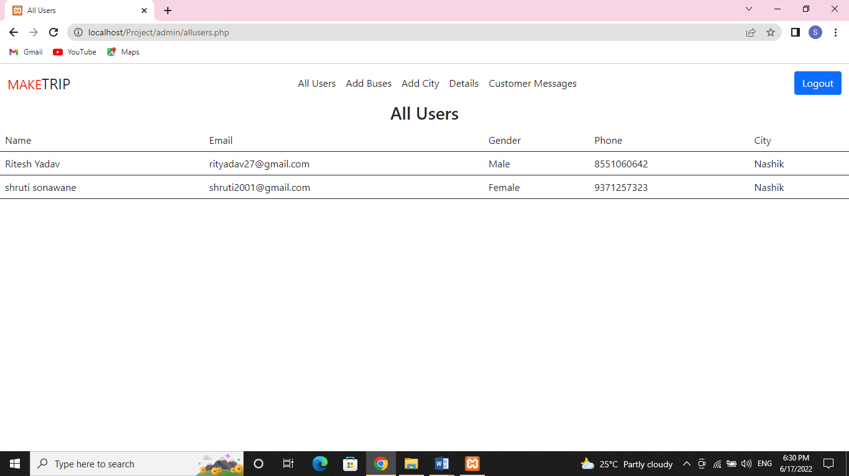
Admin can view all users information.

Slide 32
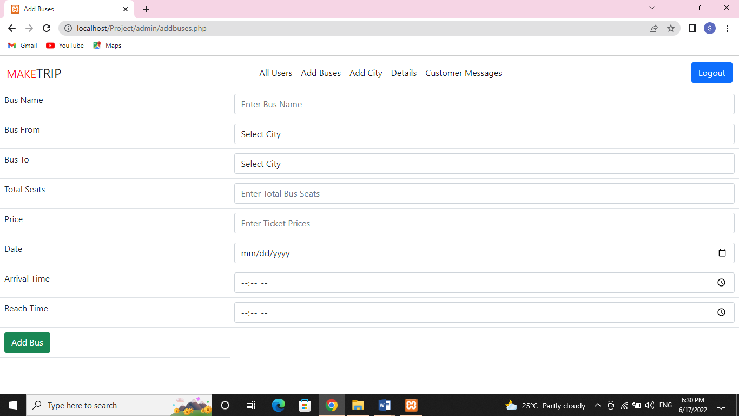
Admin can add buses.

Slide 33
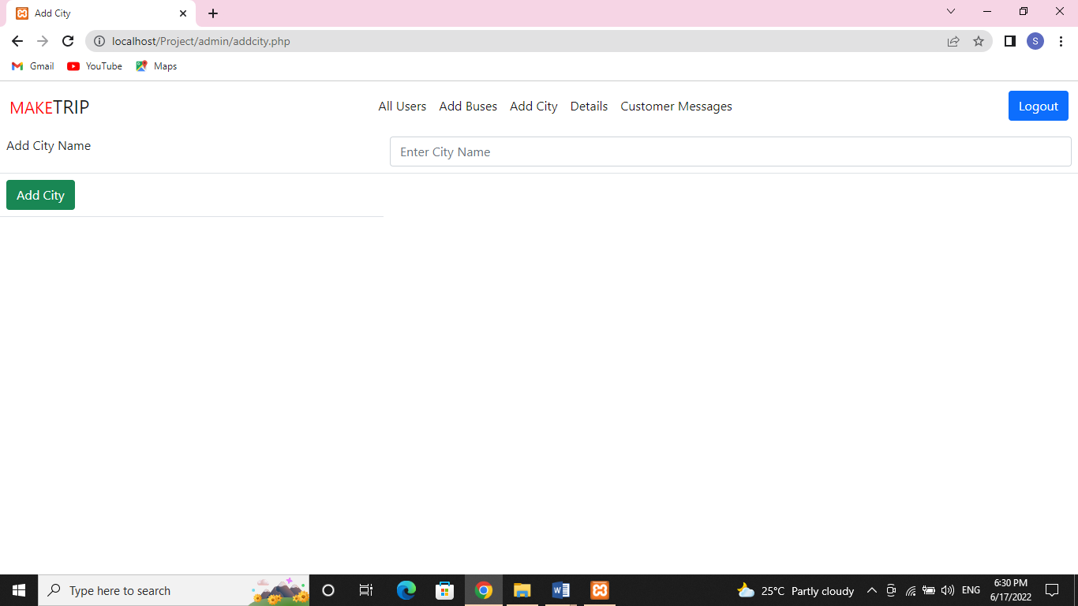
Admin can add city.

Slide 34

Admin can view booking details of customers.

Slide 35
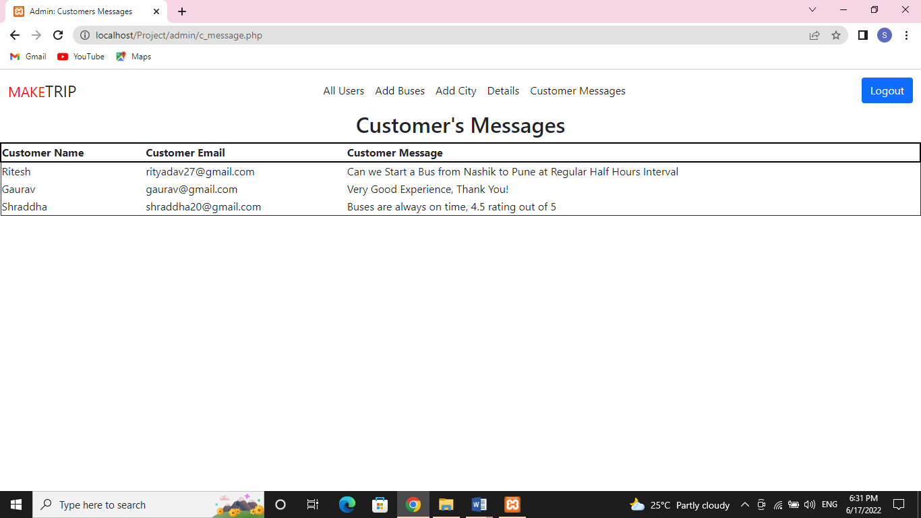
Admin can view feedbacks/comments from customers.

Slide 36
CONCLUSION:
Human errors are reduced and time is saved.
Data storage is done efficiently.
Searching a particular bus was tedious because it involved searching through over all bus schedule which required more time.
The cost for maintenance is eliminated.
Proposed system is user friendly.

Slide 37
BENEFITS OF PROPOSED SYSTEM
It is fast, efficient and reliable.
Online process is stress free and simple as booking is done within few minutes.
Avoids data redundancy and inconsistency.
Very user friendly.
Easy accessibility of data.
Number of personal required is considerably less.
Provides more security and integrity to data.
Open 24/7 for reservation.

Slide 38
BIBLIOGRAPHY
https://www.w3schools.com
https://www.abhibus.com
www.Redbus.com
www.yatra.com
www.scribd.com
PHP & MySQL, VIKRAM VASWANI, Kindle
Edition.
HTML, CSS, JavaScript & jQuery, OMAR FARUQ, Kindle Edition

Slide 39


